Slide 1
Healing Frequencies
MUSIC, LIGHT & RESONANCE

Slide 2
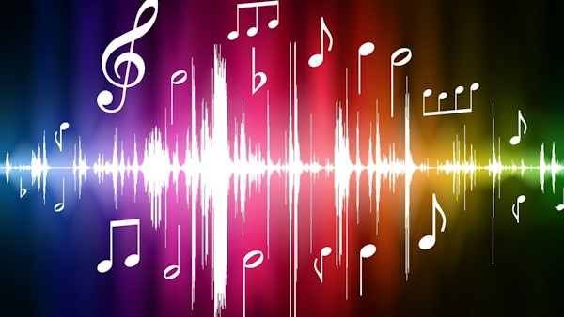

Slide 3
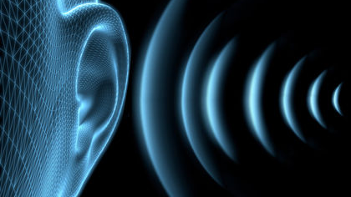

Slide 4
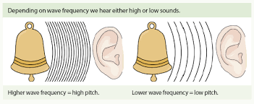

Slide 5
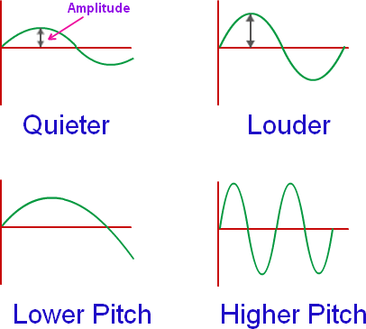

Slide 6
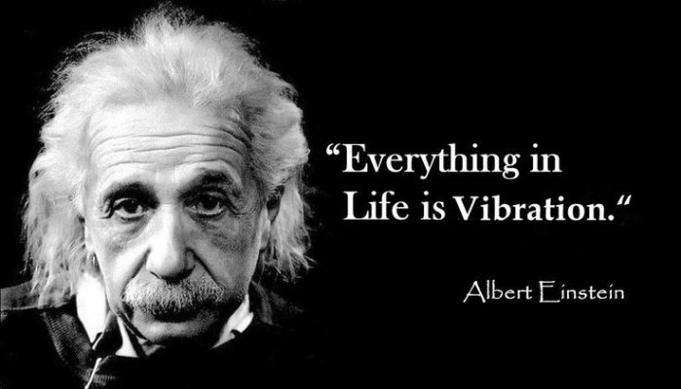

Slide 7
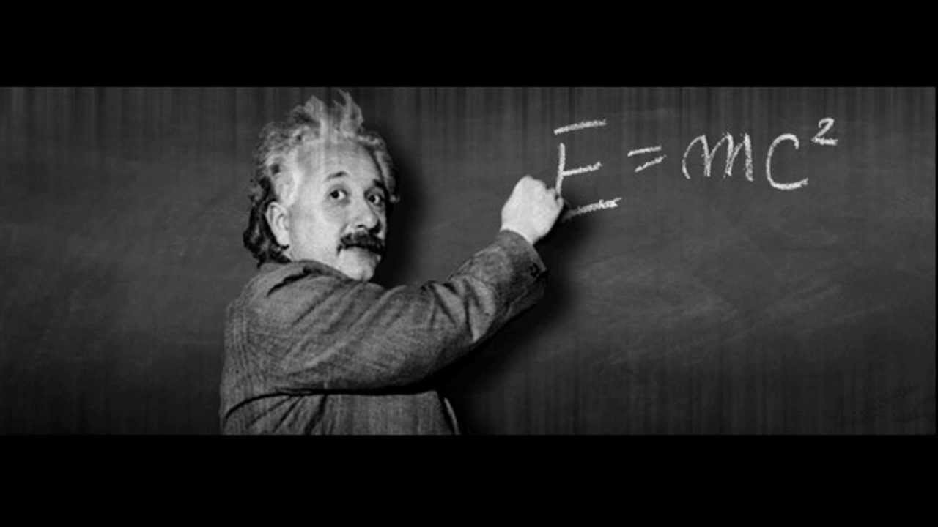

Slide 8
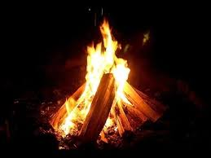

Slide 9
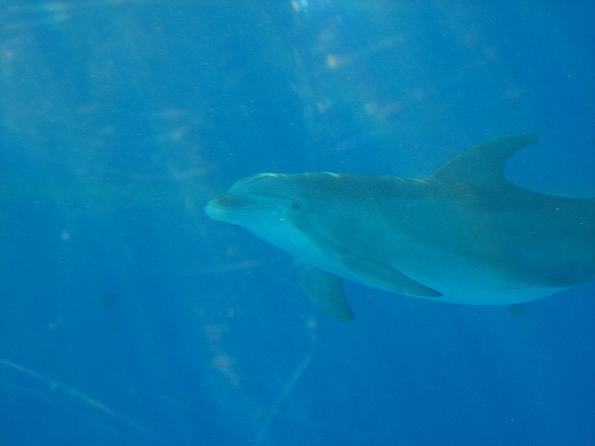
CONCERT PITCH 440 Hz since 1910

Slide 10
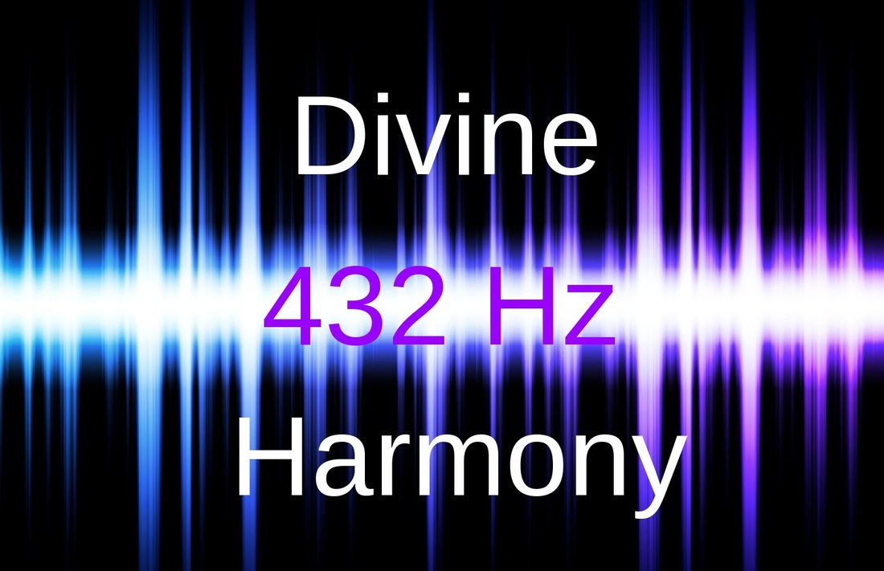

Slide 11
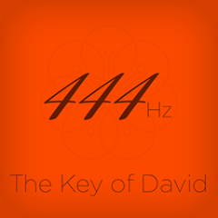

Slide 13
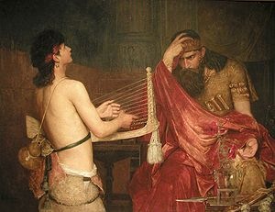

Slide 15
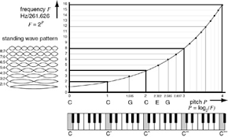

Slide 16
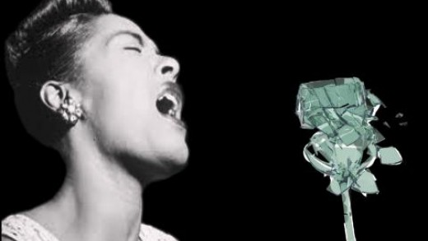

Slide 17
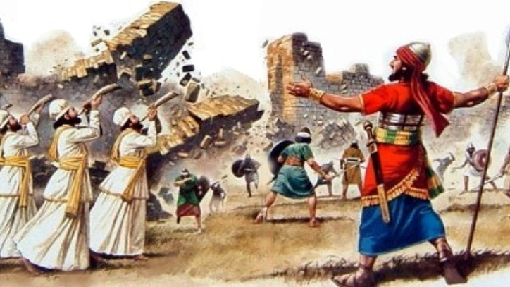

Slide 18
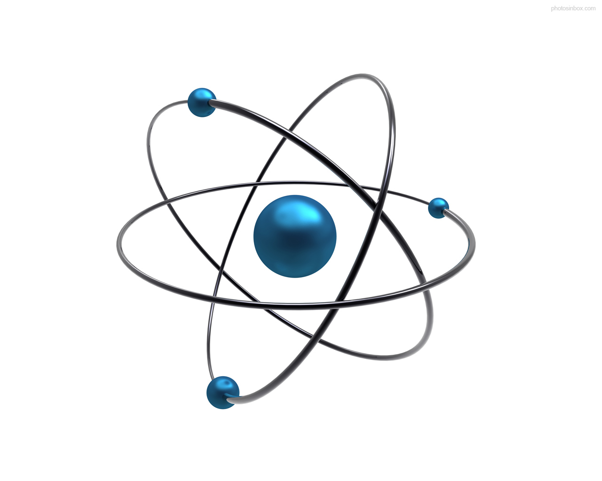

Slide 19
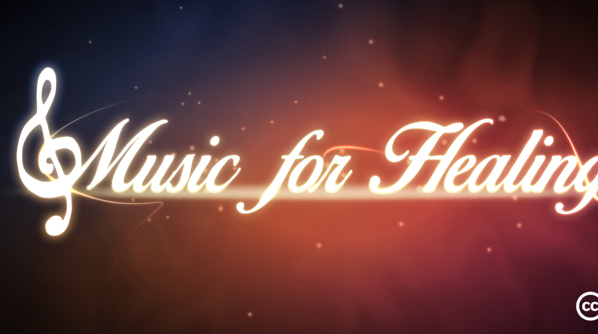

Slide 20
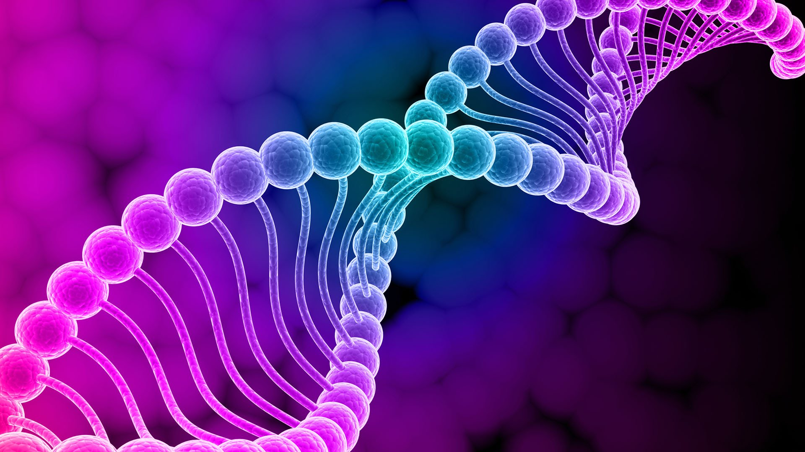

Slide 21
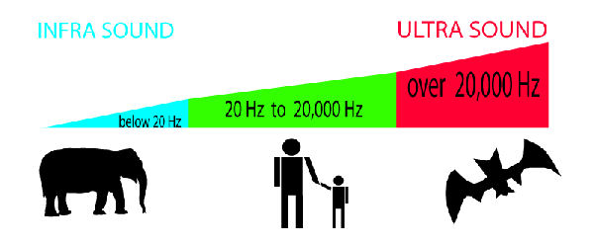

Slide 23
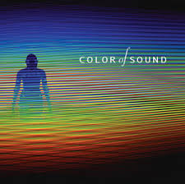

Slide 24
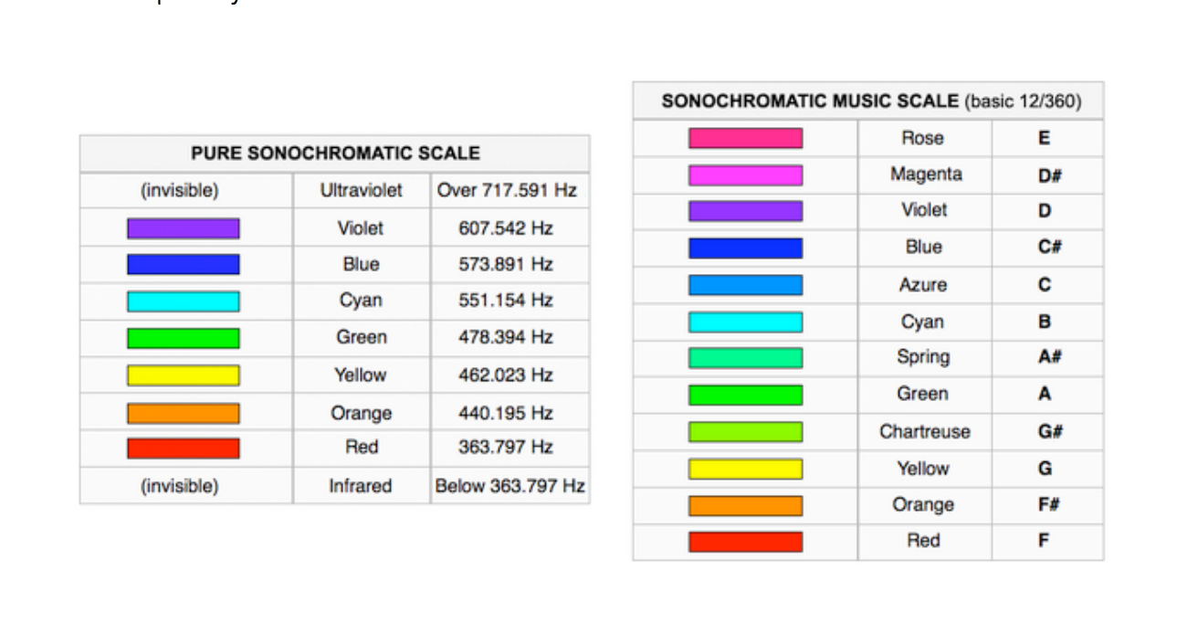

Slide 25
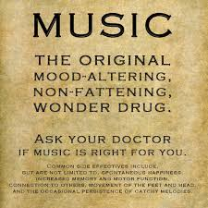

Slide 27
The entire SONIC SPECTRUM can only be heard in ONE PLACE on the ENTIRE EARTH!

Slide 28
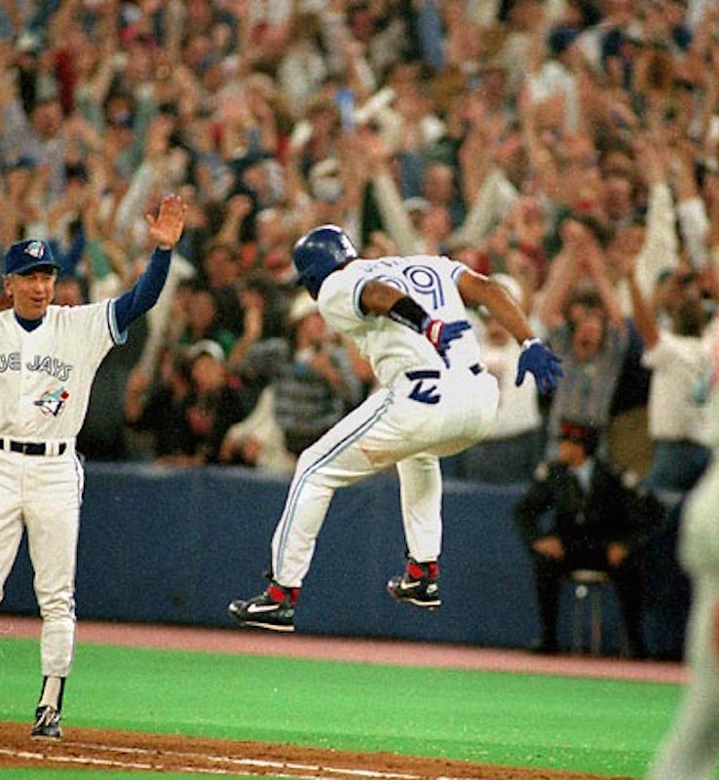
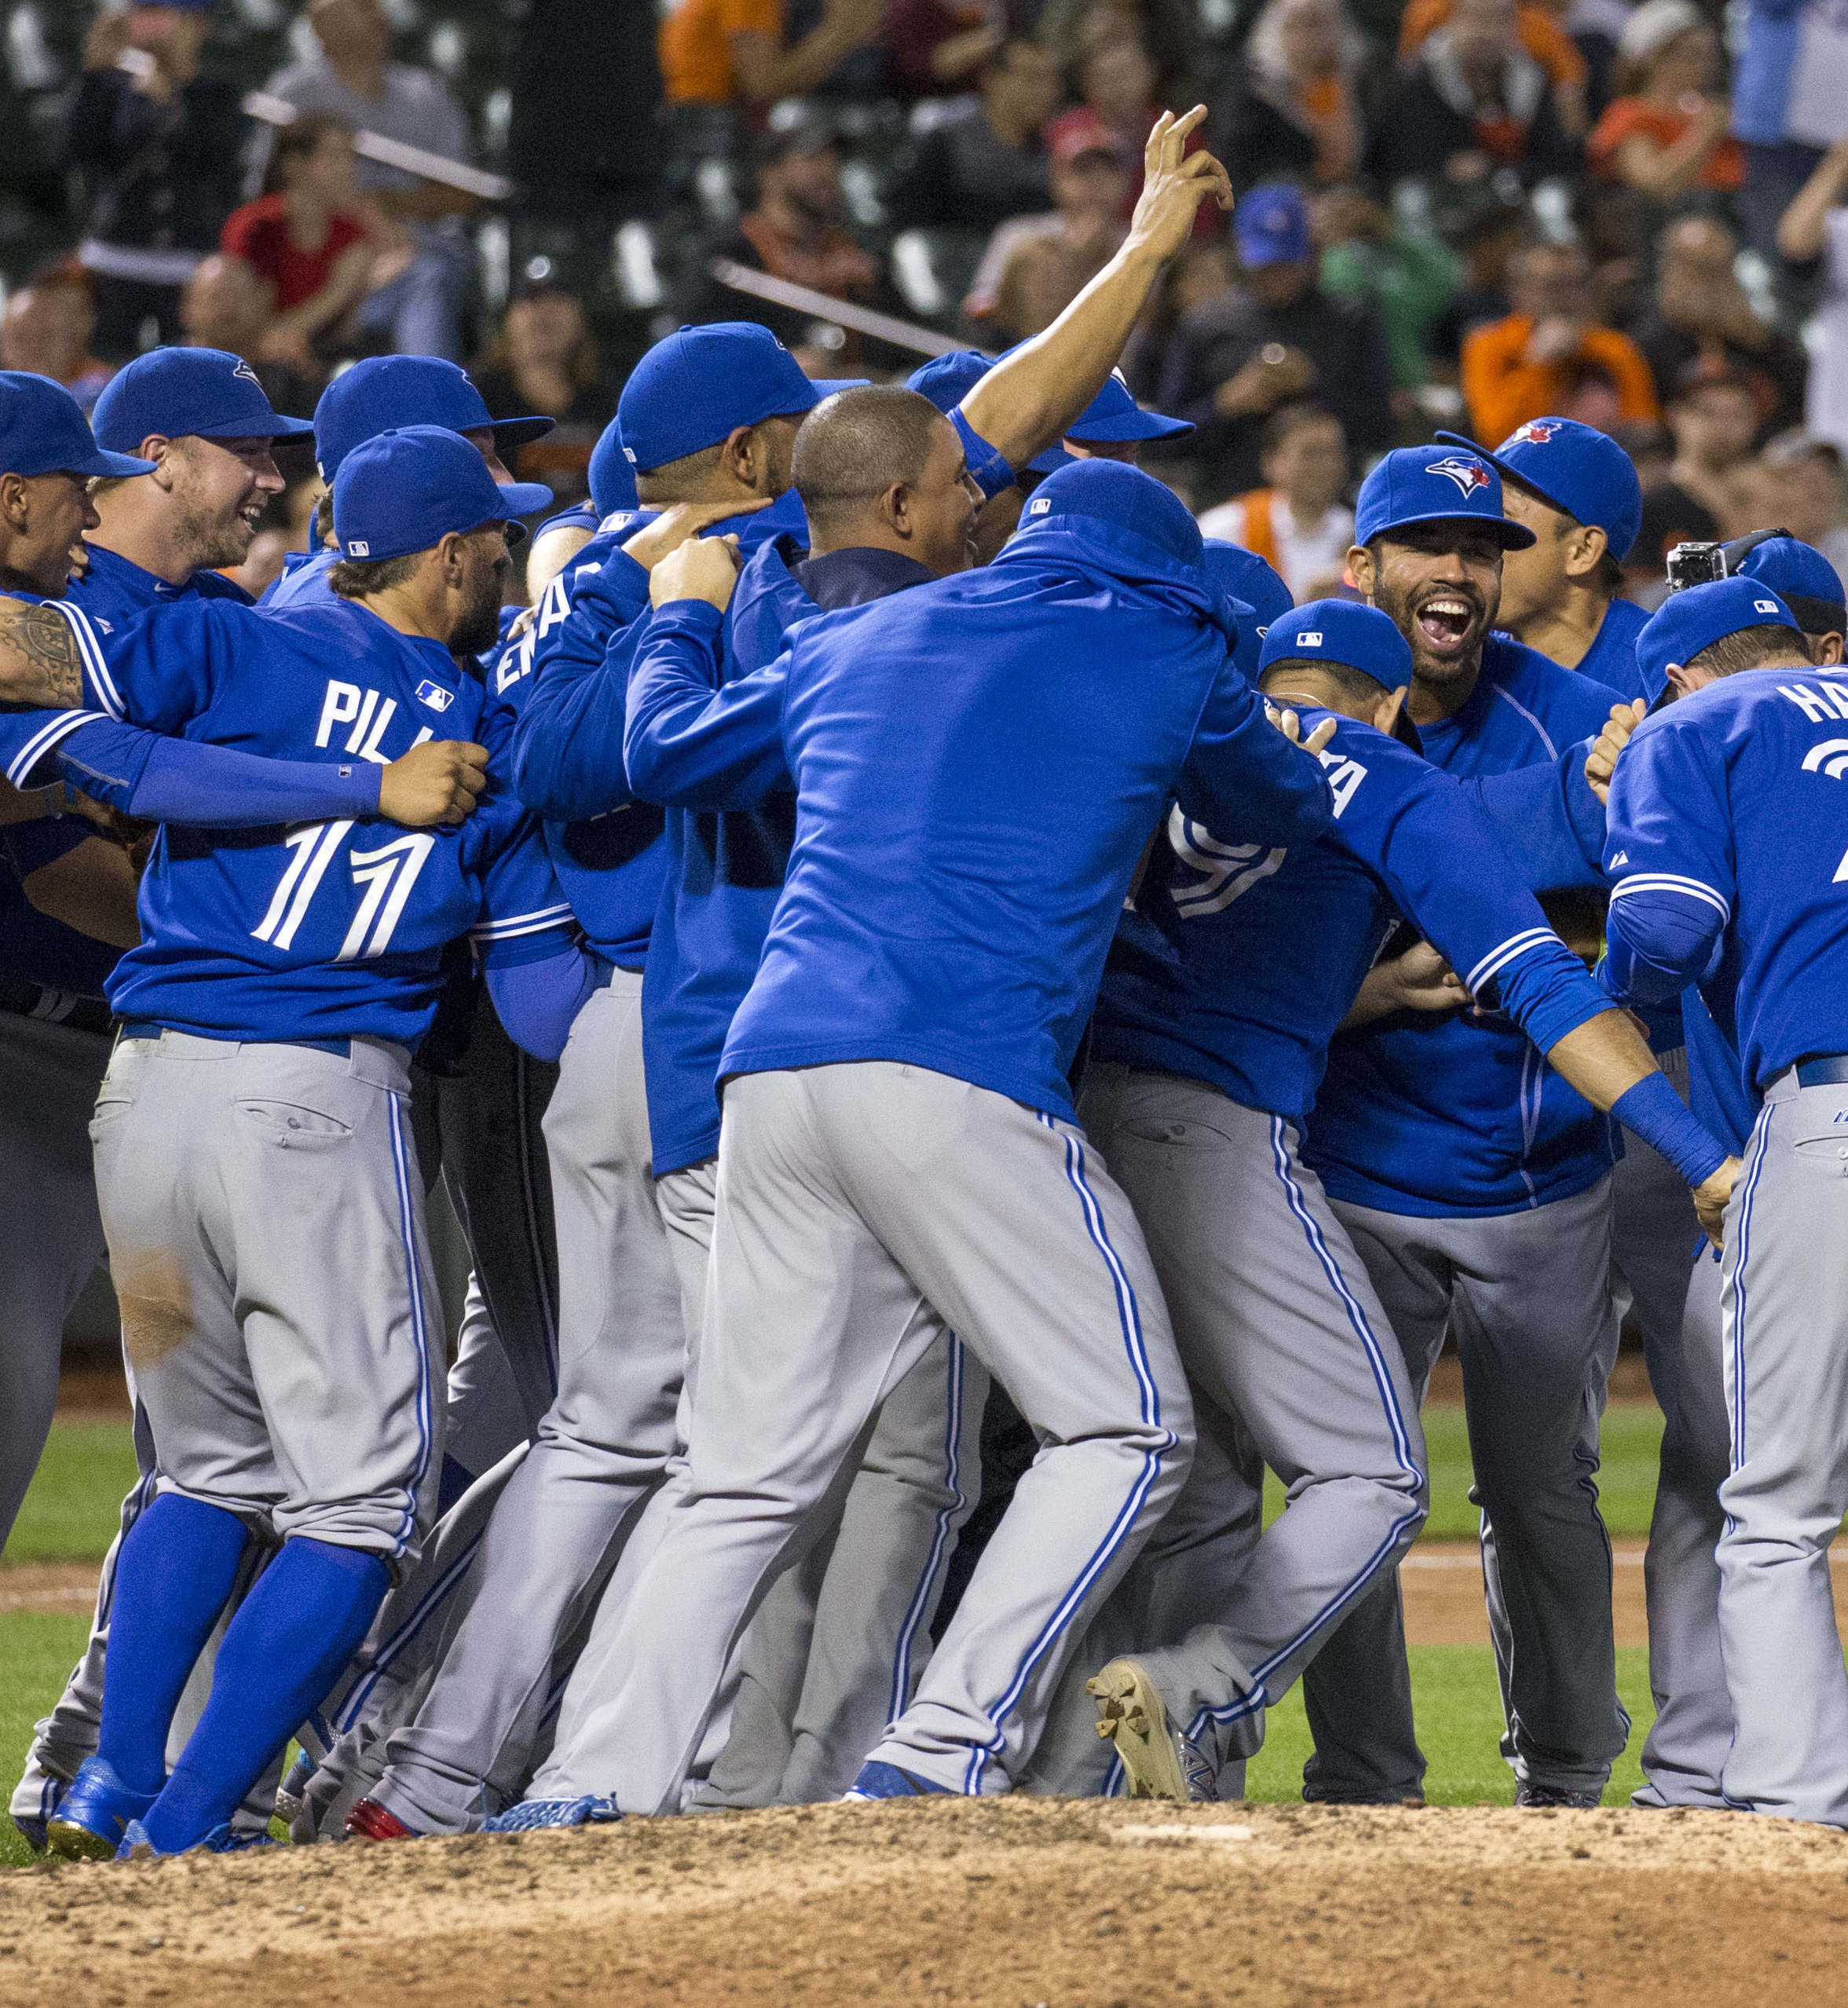
Notes:
SKYDOME! WHEN THE BLUE JAYS WON THE WORLD SERIES BACK TO BACK IN 92/93!!! NO but close

Slide 29
Call unto me and I will answer you and tell you great and unsearchable things you do not know. Jeremiah 33:3

Slide 30
Notes:
YOU DON’T KNOW IT AND NEITHER DO I! SO LORD INCREASE OUR CURIOUSITY!!!! PRAY
Do you know the difference betweena keyboard player and God? God doesn’t think he’s a keyboard player. CURIOUSITY IS THE ANTEDOTE! SO LET’S GET CURIOUS…REMOVE THE CYNICISM AND NEGATIVITY AND OPEN OUR MINDS TO WHAT YOU ARE REVEALING. WE ARE IN THE TIME OF ACTS3/21 THE RESTORATION OF ALL THINGS! AMEN START STORY OF AARONIC BLESSING FEB 2013

Slide 31
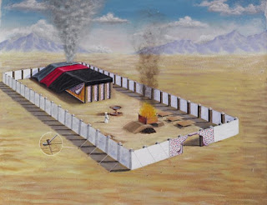
Sacred items in the temple wrapped in animal skin numbers 4
Notes:
Feb 2013 God introduced me to the world of FREQUENCIES THROUGH a search for the Aaronic Blessing. The lord bless you and keep you, make his face to shine upon you and give you his peace. Bless PASTOR DAVE…HE ANSWER YOUR PRAYER! Numbers 4 when they took down the Tent of Meeting they were to put WRAP THE SACRED ITEMS IN BLUE CLOTH and wrap it on DOLPHIN/PORPOISE SKIN! WHY??? I spend the whole day studying this Why DOLPHIN SKIN? Where did they get dolphin skin in the desert anyway?

Slide 32
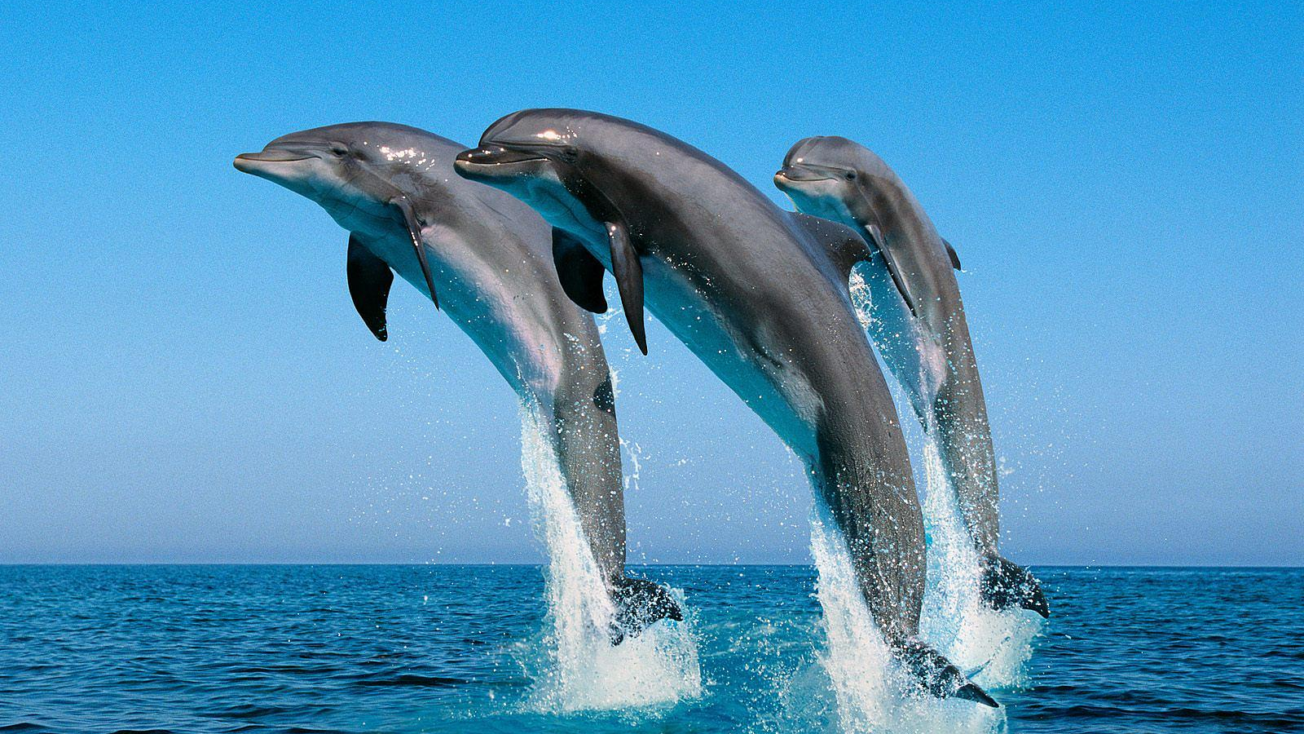

Slide 33
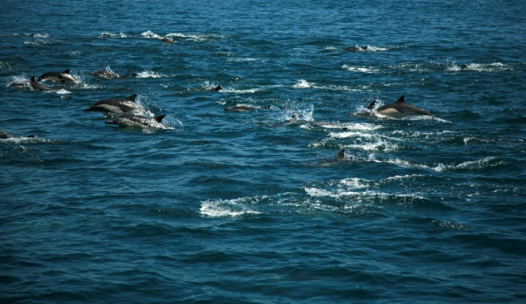
Dolphin Super Pod approximately 100,000 dolphins off
Coast of California Feb 2013
Notes:
I didn’t know about healing frequencies but GOD WANTED ME TO KNOW ABOUT THEM. FEB 2013 STORY OF SUPER POD/PROPHETIC EXP THEN 3 MONTH A YEAR IN MEXICO FOR 3 YEARS. Went to GREAT LENGHTS TO TEACH US ABOUT HEALING FREQUENCIES.

Slide 34
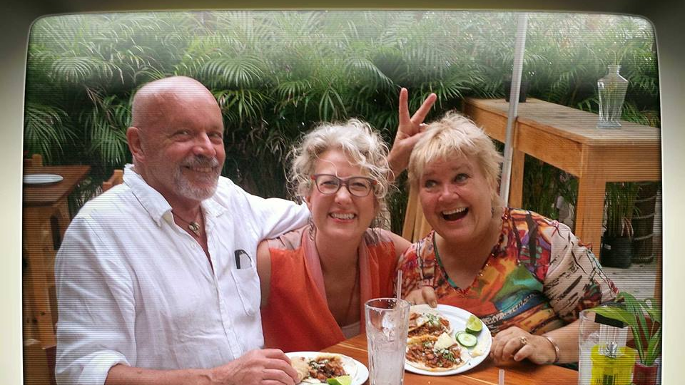
Notes:
Donna Carey who was working with The University of Miama Research Project in to Dolphins and the impact of their Vocalization/Echo locating on Spinal Cord Injuries.

Slide 35
DOLPHINS VOCALIZE @ 8hz
8Hz INAUDIBLE
PRESENT IN HARMONIC FIELD OF EARTH @432hz
ABILITY TO GENERATE Alpha & Theta waves
POSITIVELY AFFECTS BRAIN AND CELLS
BALANCES NERVOUS SYSTEM
CALMING
EASES STRESS RESPONSE

Slide 36
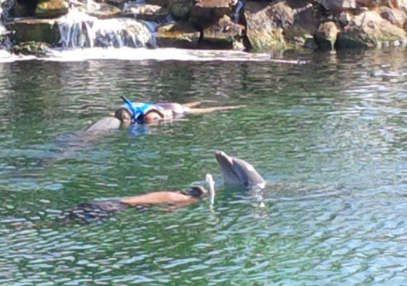
Dolphin and Manuel working together! Dolphin is paying CLOSE ATTENTION to the area of Trauma. Head Injury caused spinal cord paralysis.

Slide 37
GOD WANTS US TO HAVE A HEALTHY NERVOUS SYSTEM.
Notes:
God wants to heal us. He wants us to UNDERSTAND PRINCIPLES THAT ARE FOUNDATIONAL TO LIFE AND HEALTH. HE CARES ABOUT US . HE CARES THAT WE ARE NOT WELL. THAT WE ARE BEING OVERWHELMED BY THE WRONG FREQUENCIES AND HE HAS A SOLUTION. ITS RESONANCE AND IT GOES ALL THEY WAY BACK TO KING DAVID, THE FIRST MUSICIAN. THE KEY OF DAVID!

Slide 38
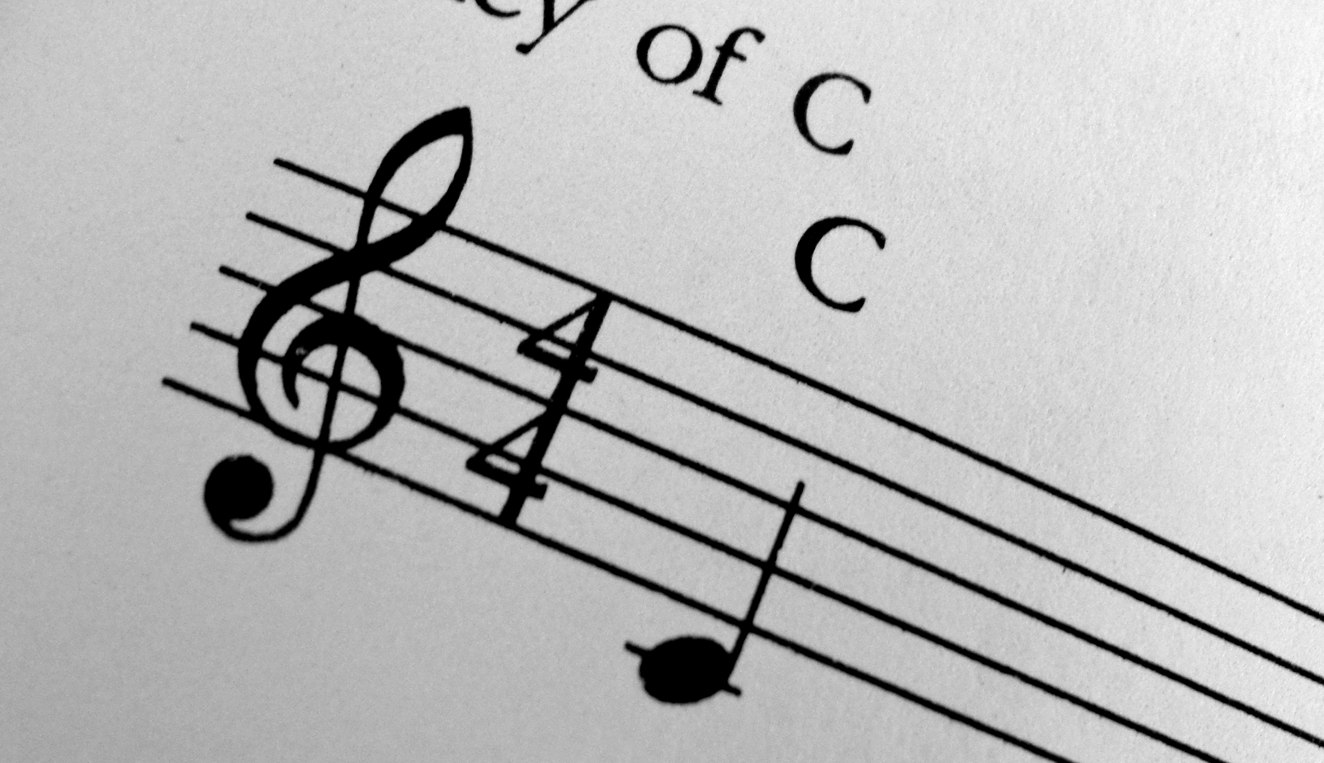
KEY OF DAVID! And the key of the House of David I will lay upon his shoulder; he shall open and no one shall shut…. Isaiah 22:22
Notes:
Key of David

Slide 39
RESONANCE My word that comes from My mouth will not return to Me empty, but it WILL ACCOMPLISH what I please and will prosper in what I send it to do. Isaiah 55:11 On EARTH as it is in HEAVEN!
Notes:
Our lives are meant to live in resonance with the Sound of Heaven. We are created to RESONATE WITH THE HEART OF GOD, TO RESPOND TO HIS VOICE. On Earth as it is in Heaven was Jesus prayer. He wants RESONANCE with us. He wants our lives to resound with HOPE AND FAITH. To bring the WORDS OF LIFE to any situation we are in. SPEAK WITH AUTHORITY.To bring the SOUND OF HIS VOICE to peoples lives through our RELATiONSHIP WITH HIM.

Slide 40
RESONANCE is effortless when the heart is in tune! RESONANCE IS A RESPONSE
Notes:
WE RESPOND TO GOD VOICE. WHAT ABOUT YOUR VOICE?

Slide 41
Notes:
SHARRY EDWARDS….Shania twain lost her voice when her marriage broke up We are surrounded by frequencies from cell phones, wifi and microwave towers that are impacting our bodies in a way that has never been seen before.

Slide 42
Life and death are
In the power of the TONGUE or VOICE!
Prov 18-21
Notes:
When your speak your tone vibrates, creating FREQUENCIES that we call WORDS. Whenever you speak YOU ARE CREATING REALITIES. YOU HAVE WHAT YOU SAY.

Slide 44
Masuro Emoto
Hidden Messages in Water
Notes:
MOST CAPITVATING ILLUSTRATION OF LIFE AND DEATH NATURE OF WORDS. Studies WORD FREQUENCY. Photos of FROZEN WATER CRYSTALS formed under a microscope while speaking words. Words different like SNOWFLAKES. HATE/SATAN/CHAOS/DEATH produced disfigured broken forms. FREQUENCY AFFECTS MATTER. REMEMBER OUR BODIES ARE 70% WATER!!!

Slide 46
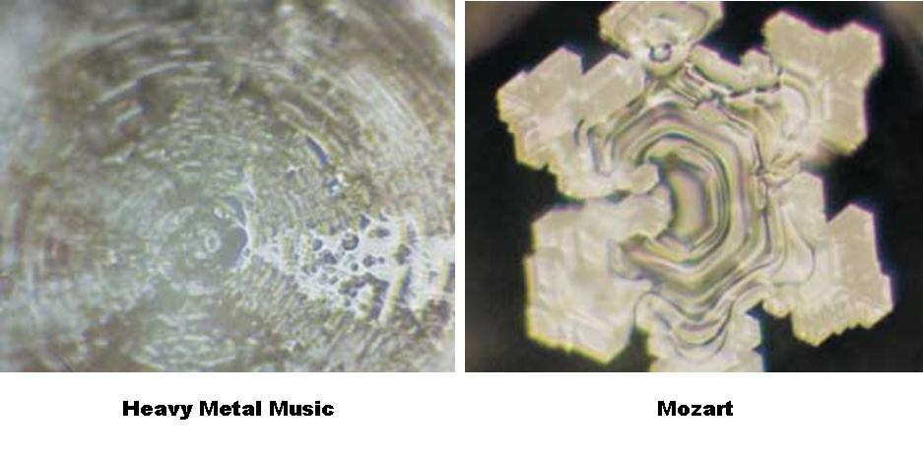

Slide 47
OUR BODIES ARE 70% WATER!!! EVERY CELL IN OUR BODY LISTENS TO WHAT WE SAY Say “YOU ARE BEAUTIFUL, LOVED!” DON’T SAY “I HATE MY BODY!” LIFE AND DEATH ARE IN THE WHAT WE SAY! SPEAK WISELY, WITH LOVE

Slide 48
Notes:
SPOKEN WORDS ARE FREQUENCIES BUT WHAT ABOUT WIFI/MICROWAVER TOWERS/CELL PHONES? We are affected by frequencies all day everyday. Some think we are in a BioAccoustic crisis affecting our mental and physical wellbeing. Our bodies recognize the world through frequencies. When you eat, your body is looking at food through the lens frequencies. Vitamins and minerals are Frequecies. We are being bombarded by frequencies 24/7 and they are disruption our ability to recognize even the most basic things. SHARE PRESONAL STORY. NOT RECOGNIZING AMINO ACID PROTEINS. I was treated using frequency therapy. BIO FEEDBACK We are surrounded by frequencies from cell phones, wifi and microwave towers that are impacting our bodies in a way that has never been seen before.

Slide 49
Notes:
Music is powerful! God created music. He created the Frequencies to heal us. SING TO THE LORD! SHOUT WITH A VOICE OF TRIUMPH! REMEMBER JERICHO…RAMS HORNS CHANGED THE ATMOSPHERE. THE SHOUT OF THE PEOPLE BROUGHT THE WALLS DOWN. SLAVES WITH NO VOICE SUDDENLY LEARNED THEY HAD A POWERFUL VOICE!

Slide 50
God has already provided an answer! WORSHIP! MUSIC! SOUND.

Slide 51
6 SOLFFEGIO TONES: 396hz 417hz 528hz 639hz 741hz 852 hz Seen, Heard and Felt

Slide 52
SO HOW DOES IT WORK? THE TONGUE HAS THE POWER OF LIFE AND DEATH AND THOSE WHO LOVE IT WILL EAT ITS FRUIT. Proverbs 18:21

Slide 53
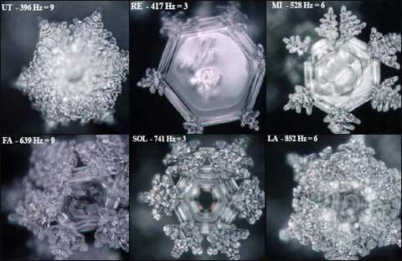

Slide 54
6 SOFFEGIO TONES: 396hz 417hz 528hz 639hz 741hz 852 hz SEEN HEARD FELT
King David CHIEF MUSICIAN
The FIRST Musician!
“I will place on his shoulder the KEY to the house of David; what he opens no one can shut, and what he shuts no one can open”
Isaiah 22:22
IN ADDITION TO GLORIFYING GOD DID GOD GIVE DAVID A KEY/FREQUENCY THAT CAN HEAL THE MIND AND BODY

Slide 55
6 SOFFEGIO TONES: 396hz 417hz 528hz 639hz 741hz 852 hz SEEN HEARD FELT
396 Hz Open Door
OPENESS TO RECEIVE WHILE LISTENING TO GOD
FEAR GUILT SHAME SUBSIDE
All who look to him are radiant and will NEVER feel ashamed.
MAY HAVE POSITIVE EFFECT ON BLOOD, LIVER, BONES, BRAIN AND NEUROTRANSMISSION, KIDNEY FUNCTION
COLOUR OF FREQUENCY IS DEEP RED OR GARNET

Slide 56
6 SOFFEGIO TONES: 396hz 417hz 528hz 639hz 741hz 852 hz SEEN HEARD FELT
417 Hz Desert Sojourn
BREAKS NEGATIVE CYCLES
PROCRASTINATION, SELF MEDICATING
MAY HAVE POSITIVE EFFECT ON LARGE INTESTINE, ENZYME PRODUCTION, DIGESTIONS, METABOLISM, GALLBLADDER
COLOUR OF THIS FREQUENCY IS BRIGHT RED

Slide 57
6 SOLFFEGIO TONES: 396hz 417hz 528hz 639hz 741hz 852 hz SEEN HEARD FELT
528 Hz TRANSFORMATION
MOST STUDIED IN THE FIELD OF SCIENCE AND MEDICINE
PROVEN TO RESTORE BROKEN DNA, THE SOURCE OF ALL DIS-EASE
BALANCE HORMONES, MUSCLE TENSION, PERICARDIUM HEART MUSCLE, WEIGHT, LYMPHATIC AND CIRCULATION
MIRACLE FREQUENCY!
COLOUR OF FREQUENC IS BRIGHT GREEN
Notes:
THE MOST STUDIED FREQUENCY. PROVEN TO ALTER DNA!

Slide 58
6 SOLFFEGIO TONES: 396hz 417hz 528hz 639hz 741hz 852 hz SEEN HEARD FELT
639 Hz THE BRIDGE
SEEMS TO FOSTER FORGIVENESS
HELPS YOU GET OVER YOURSELF
MAY PEACE WITH ONE ANOTHER
MAY BE EFFECTIVE FOR ENDOCRINE SYSTEM
ADRENAL GLANDS AND GALLBLADDER
COLOUR OF THIS FREQUENCY IS BLUE

Slide 59
6 SOFFEGIO TONES: 396hz 417hz 528hz 639hz 741hz 852 hz SEEN HEARD FELT
741 Hz GREAT AWAKENING
MOST PEOPLE FIND HAS PROFOUND EFFECT ON EMOTIONS
CLEANSING TEARS, AWARENESS OF SPIRITUAL LIFE, CALL OF GOD
MAY IMPROVE THYMUS FUNCTION, CLEANSE INFECTION, IMPROVE FUNCTION OF PANCREASE, HEART, BLOOD AND CIRCULATORY SYSTEM
CORRESPONDING COLOUR IS INDIGO

Slide 60
6 SOFFEGIO TONES: 396hz 417hz 528hz 639hz 741hz 852 hz SEEN HEARD FELT
852 Hz THE MAJESTIC
CELEBRATION OF KING OF KINGS!
PURELY SPIRITUAL FREQUENCY
NO KNOWN PSYCHOLOGIAL AFFECT
ABILITY TO CONECT US IN WORSHIP
COLOUR FREQUENCY IS DEEP PURPLE

Slide 61
6 SOFFEGIO TONES: 396hz 417hz 528hz 639hz 741hz 852 hz SEEN HEARD FELT
RESEARCH
MAN DISCOVERED THESE FREQUENCIES BUT GOD CREATED THEM! HE IS RESTORING THEM!
INTERNET IS FULL OF COSMIC WEIRDNESS ON THE SUBJECT BUT GOD IS RESTORING THE KNOWLEDGE OF THESE “KEYS OF DAVID. (Read WholeTones)
THERE IS INTEGRITY IN THE RESEARCH!
Dr. Leonard Horowitz, Dr. Joseph S. Puleo
Source Michael Tyrrell, Wholetones.

Slide 62
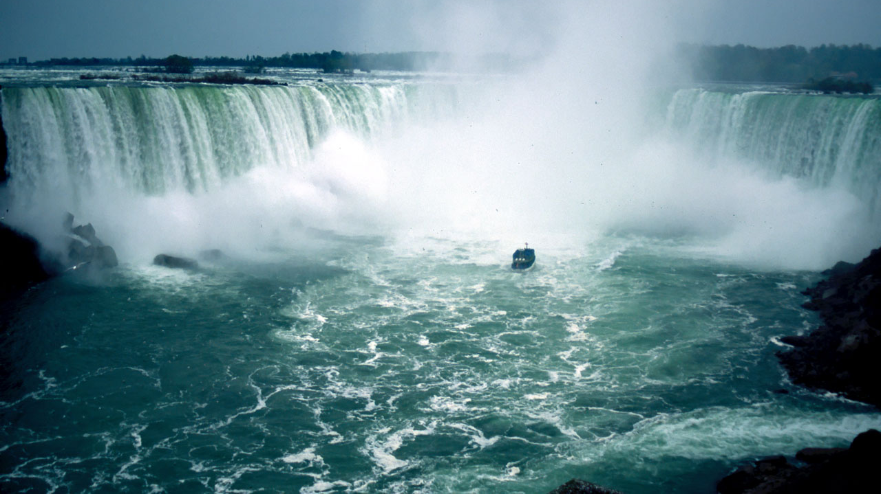
HIS VOICE WAS LIKE THE SOUND OF MANY WATERS
Ezekiel 43:2

Slide 63
The entire SONIC SPECTRUM can only be heard in ONE PLACE on the ENTIRE EARTH!

Slide 64
Niagara Falls!

Slide 65
WHEN WE LEAD WORSHIP WE USE 444Hz
WORSHIP HEALS YOU
GOD ALWAYS INTENDED
MUSIC TO HEAL AND BLESS HIS PEOPLE.

Slide 66
Notes:
NIAGARA FALLS IS THE ONLY PLACE ON EARTH WHERE YOU CAN HEAR THE FULL SONIC SPECTRUM.
MAKE A POINT OF GOING TO NIAGARA FALLS. DON’T JUST LOOK BUT LISTEN. GOD’S VOICE IS IN CREATION SPEAKING TO US
HE SPOKE OUT OF THUNDERCLOUDS AT MT SINAI, HE SPEAKES IN THE STILL SMALL VOICE THROUGH RESONANCE.
WE ARE INSTRUMENTS THAT ARE CREATED TO RESONATE WITH HEAVEN. OUR LIVES ARE MEANT TO RELEASE HIS WORD, THE FREQUENCY OF HEAVEN TO CHANGE THE ATMOSPHERE ON EARTH.
THIS MESSAGE IS ABOUT HEALING FREQUENCIES BUT THERE IS SO MUCH MORE TO KNOW ABOUT HOW TO RESONATE WITH THE SOUND OF HEAVEN TO BRING HEAVEN TO EARTH.

